Slide 1
Metric of time series

Slide 2
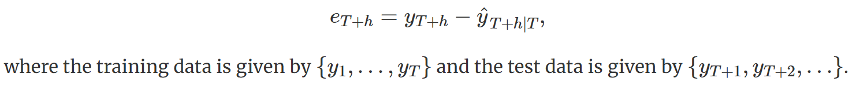
A forecast “error”
A forecast “error” is the difference between an observed value and its forecast
forecast errors are different from residuals in two ways.
First, residuals are calculated on the training set while forecast errors are calculated on the test set.
Second, residuals are based on one-step forecasts while forecast errors can involve multi-step forecasts.

Slide 3
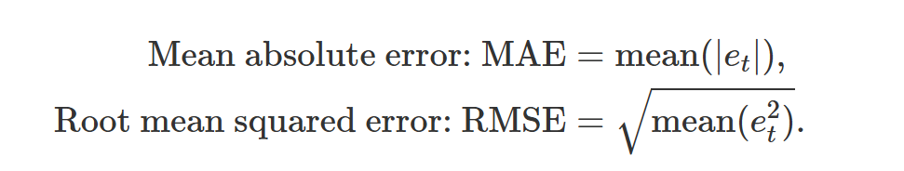
scale-dependent measures
The forecast errors are on the same scale as the data. Accuracy measures that are based only on e_{t} are therefore scale-dependent and cannot be used to make comparisons between series that involve different units

Slide 4

Percentage errors
The percentage error is given by p_{t}=100e_{t}/y_{t}.
Percentage errors have the advantage of being unit-free, and so are frequently used to compare forecast performances between data sets
disadvantage: being infinite or undefined if yt=0 for any t
They also have the disadvantage that they put a heavier penalty on negative errors than on positive errors

Slide 5
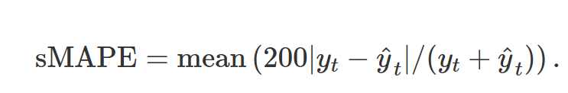
“symmetric” MAPE
However, if yt is close to zero, ^yt is also likely to be close to zero

Slide 6
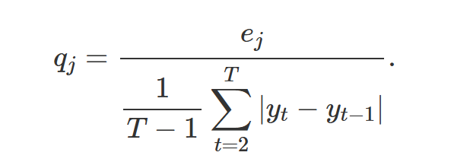
Scaled errors
For a non-seasonal time series, a useful way to define a scaled error uses naïve forecasts:
Because the numerator and denominator both involve values on the scale of the original data, qj is independent of the scale of the data.
A scaled error is less than one if it arises from a better forecast than the average one-step naïve forecast computed on the training data

Slide 7
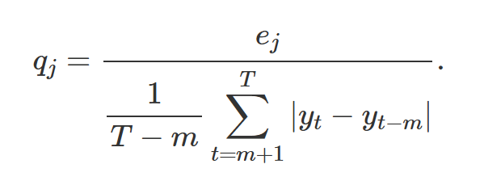
Scaled errors
For seasonal time series, a scaled error can be defined using seasonal naïve forecasts:

Slide 8
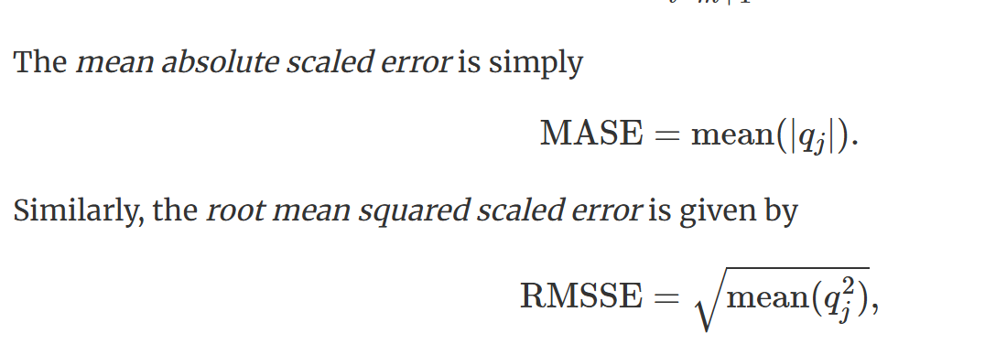
Scaled errors

